Slide 1
SOLAR BASED AUTOMATIC LIGHT CONTROL SYSTEM(ON/OFF)
MINOR PROJECT
on
Advisor:
Dr. Nithin Kumar Y.B.
Associate Professor
Subject:
Control Systems
EC302
Presented By:
Karteek Dokala(21ECE1015)
Jayanth Ruthala(21ECE1029)
DEPARTMENT OF ELECTRONICS AND COMMUNICATION ENGINEERING
23rd November 2023

Slide 2


Introduction :
Solar based automatic lighting system is designed to automatically switch ON the light alongside the roads or in the remote areas where electrical transmission lines are not available or the light lamp just outside our house on the onset of dark weather or switch them off automatically after sunrise or during the light hours. We need to save or conserve energy because most of the energy sources we depend on, like coal and natural gas can't be replaced. Once we use them up, they're gone forever. Saving power is very important, instead of using the power in unnecessary times it should be switched off.

Slide 3
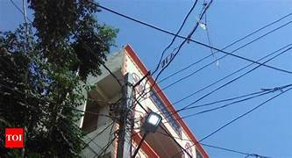
Problem Statement:
“Designing an energy-efficient Solar based automated lighting system to enhance sustainability and reduce electricity consumption in outdoor spaces”

Slide 4
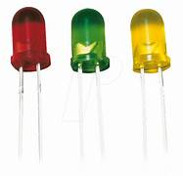
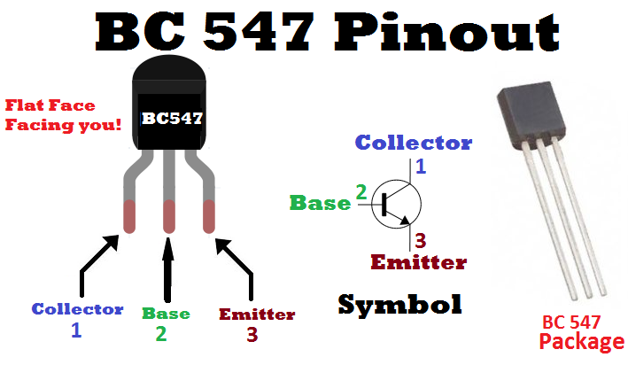
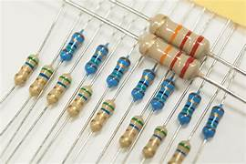
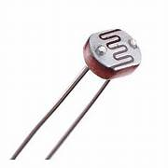

List of components:
Transistor (BC 547-NPN)
LDR (Light Dependence Resistor)
Resistors
LED (Light Emitting Diode)
PCB (Printed Circuit Board)
Battery
Solar panel

Slide 5
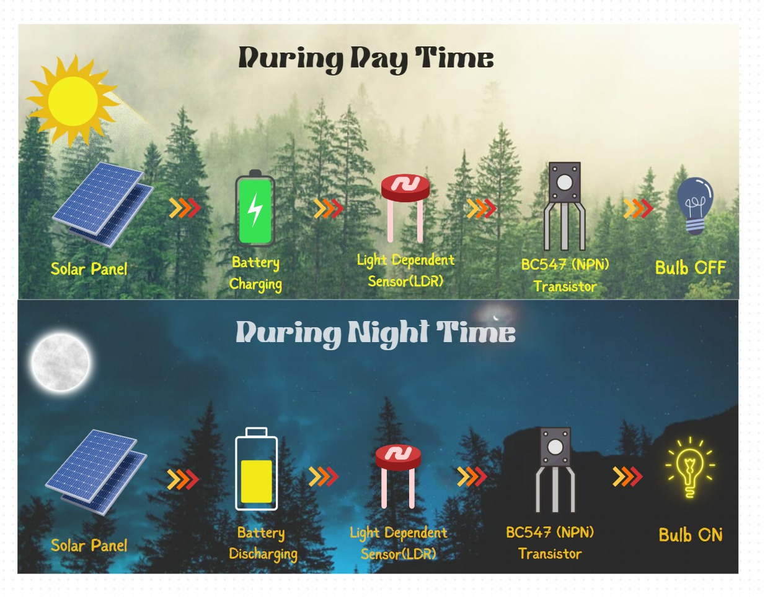
Block diagram:

Slide 6
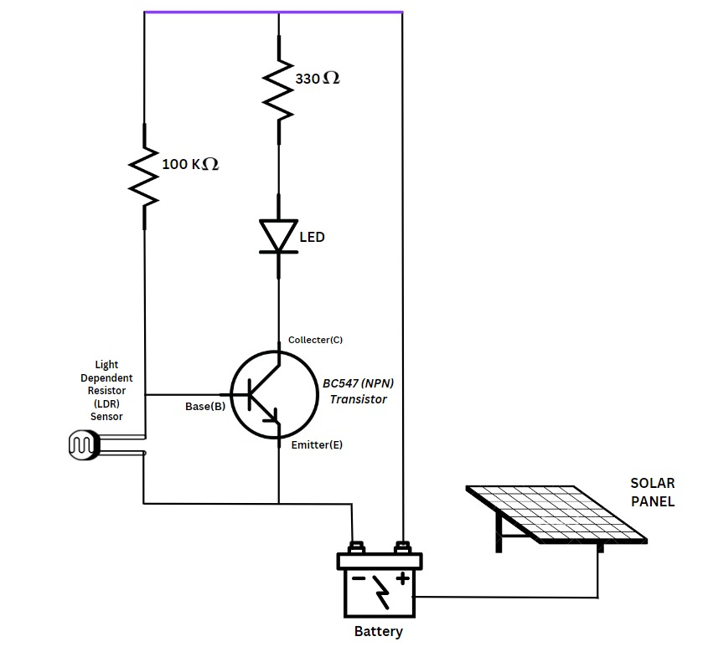
Working principle:
LDR offers Very high Resistance in darkness. In this case the voltage drop across the LDR is more than 0.7V. This voltage is more sufficient to drive the transistor into saturation region. In saturation region, IC (Collector current) is very high. Because of this IC. The relay gets energized, and switches on the light.
LDR offers Very low Resistance in brightness. In this case the voltage drop across the LDR is less than 0.7V. This voltage is not sufficient to drive the transistor into saturation region. Then the IC (Collector current) is very low. Because of the low IC of the transistor, the transistor acts of switch OFF then the light will be switched off.

Slide 7
ADVANTAGES:
Energy savings
Low cost
Safety and Security
Automated operation
Very flexible
Easy to manufactured in sunny and rainy days, on and off time differ notice which is one of the major disadvantages of using timer circuit or manual operation for switching the street light system.
APPLICATIONS:
Street lights
Vehicle head lamps
Lights in the remote locations
Camera shutter control
Domestic lights

Slide 8
What if some dust or leaves particulate on sensor???
To avoid the above problem we can upgrade this project to the next level:
where we can place a thin and strong glass slab on top of the sensors.
we need to clean the surface of the sensor to get the accurate performance of the system.
For this we will place a wiper on top of the glass slab , such that it wipes the glass in particular interval of time.
This time interval can be provided by a inbuild clock system such that for every interval of time, the surface area of the glass slab on the sensor will be cleaned.

Slide 9

conclusion:
By developing this system…..
we can reduce the consumption of electricity .
we need not to worry about the electrical transmission lines.
No need of manual work.

